Slide 1
Amazon Product Analysis
ALY 6140 Python and Advanced Systems
Aditya Parey
Junhui Hu
Ant Gozkaya

Slide 2
Introduction
The dataset with over 10,000 records and 14 usable features—which provides a comprehensive look into the factors that influence Amazon's customer sentiment. Amazon isn’t just a leading online marketplace; it’s a powerhouse that has expanded into various industries, offering a rich landscape to explore how product attributes, pricing strategies, and brand identities impact consumer reviews.
Our goal is to forecast and evaluate review sentiment, using statistical and machine learning models to provide insights that could help both businesses and consumers understand the market dynamics better.
Methodology
Challenges
Key findings

Slide 3



01
Predicting product price range based on category features reviews and ratings
Goals of the project
02
Understanding the elements that influence average review ratings
03
Can we accurately predict the sentiment of a review based on its text and other features?

Slide 4

Exploratory Data Analysis
Popular Category
Top 10 products
A bar chart shows Popular Manufacturers and their avg rating
03
04
A bar chart shows top 10 Categories by Number of Products
Review Distribution
02
05
Price vs Avg Review
A histogram shows rating distribution
Regression Line
Price Distribution
01
06
Key Features
A histogram shows product price distribution
Correlation Matrix of Key Features
Notes:
The first step is to remove outliers. Let's define the IQR as the middle 50% of the data and calculate the lower_bound and upper_bound to ensure that extreme outliers are filtered out. Here, we only removed outliers for the price; other numerical types, such as review points, have a smaller range (1-5), and if a user gives a 1 out of 5, there should be a reason behind it, which is valuable.

Slide 5
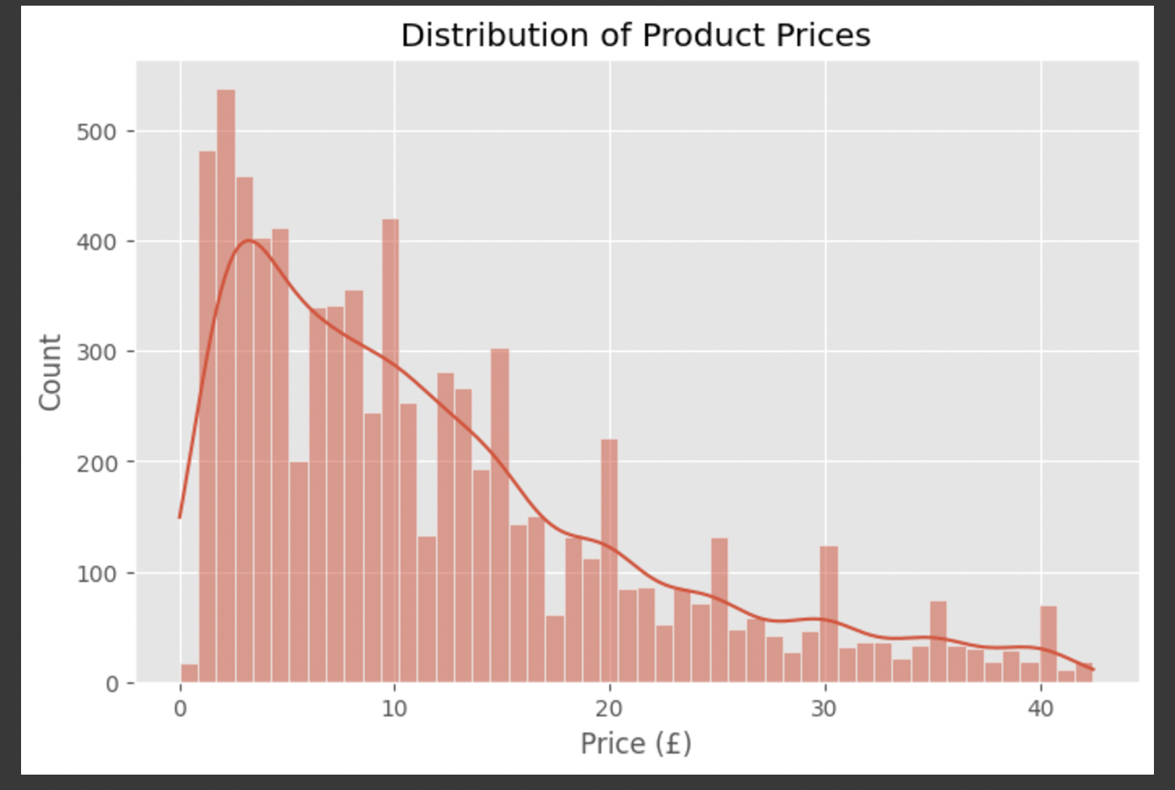
Distribution of Product Prices
This histogram visualizes the distribution of product prices in the dataset.
The x-axis represents the price in British Pounds (£), while the y-axis shows the count of products within each price range.
A Kernel Density Estimate (KDE) curve overlays the histogram, showing the smooth probability distribution of prices.
Businesses can use this distribution to understand pricing trends and adjust strategies accordingly.
Notes:
The price distribution is right-skewed, with most products around 5 and few products priced above £10. The high-priced products might belong to specific brands or the high-end market.

Slide 6
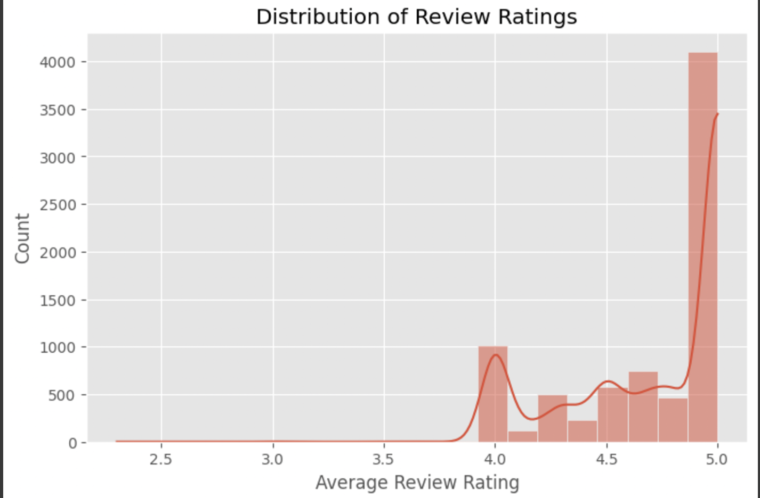
Distribution of Review Ratings
This histogram represents the distribution of average review ratings for products.
The x-axis denotes the average rating (out of 5), while the y-axis indicates the count of products within each rating range.
The KDE curve highlights a peak near 4.5–5, suggesting that most products receive positive feedback.
Consumers may rely heavily on reviews when making purchasing decisions, given the high concentration of ratings around 4.5–5.
Notes:
The price distribution is right-skewed, with most products around 5 and few products priced above £10. The high-priced products might belong to specific brands or the high-end market.

Slide 7
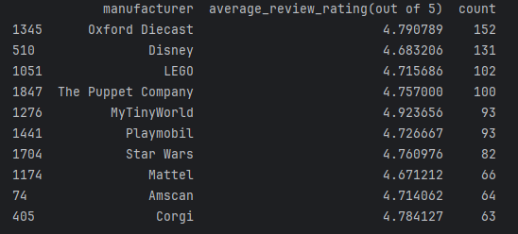
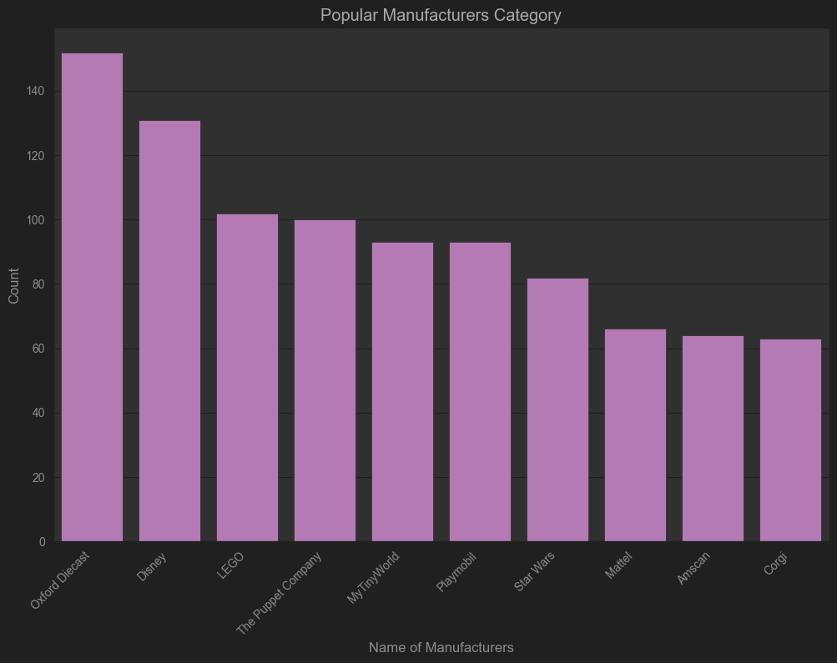
Distribution of Manufacturers
This bar chart highlights the top 10 manufacturers based on the number of products in the dataset.
The x-axis represents manufacturer names, while the y-axis shows the number of products they offer.
Reputable brands like LEGO, Disney, and Playmobil dominate the market with high product availability and strong ratings.
Manufacturers with fewer but highly rated products (e.g., MyTinyWorld) may focus on quality over quantity.
Notes:
We analyzed the Popular Manufacturers Category and found that Oxford Diecast (which is the first time I’ve heard of them) might be a major market leader in model area. They offer a wide range of products and have high sales, and this manufacturer also holds the second-highest rating among the top ten. While I understand that Disney and LEGO are well-known brands with high market acceptance, the fact that Oxford Diecast outperforms both indicates that they are extremely strong.

Slide 8
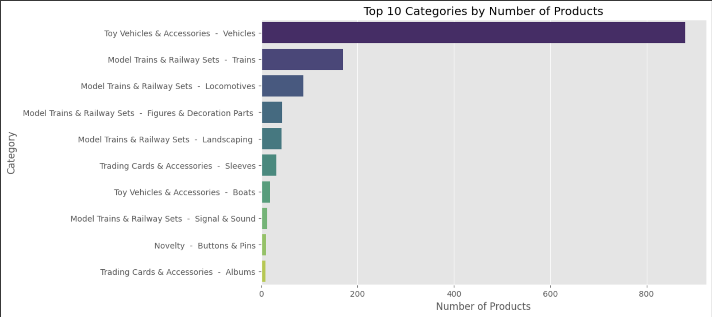
Top 10 Categories by Number of Products
This bar chart displays the top 10 product categories based on the number of products available.
The x-axis represents the number of products, while the y-axis shows the category names.
The most popular categories contain a significantly higher number of products compared to others.
Some categories may be overrepresented, suggesting high demand or wider product variety within these groups.
Notes:
This is a "Top 10 Categories by Number of Products". To avoid readers recognize "vehicle" to the real cars, I put a category before the product. So the Bar char shows, Toy Vehicles is the primary product category in the market, with high consumer demand and a greater number of suppliers. Additionally, "Toy Vehicles & Accessories," as a broader category, also includes Boats and Aircraft, indicating that the diversity of products in this category is very high.

Slide 9
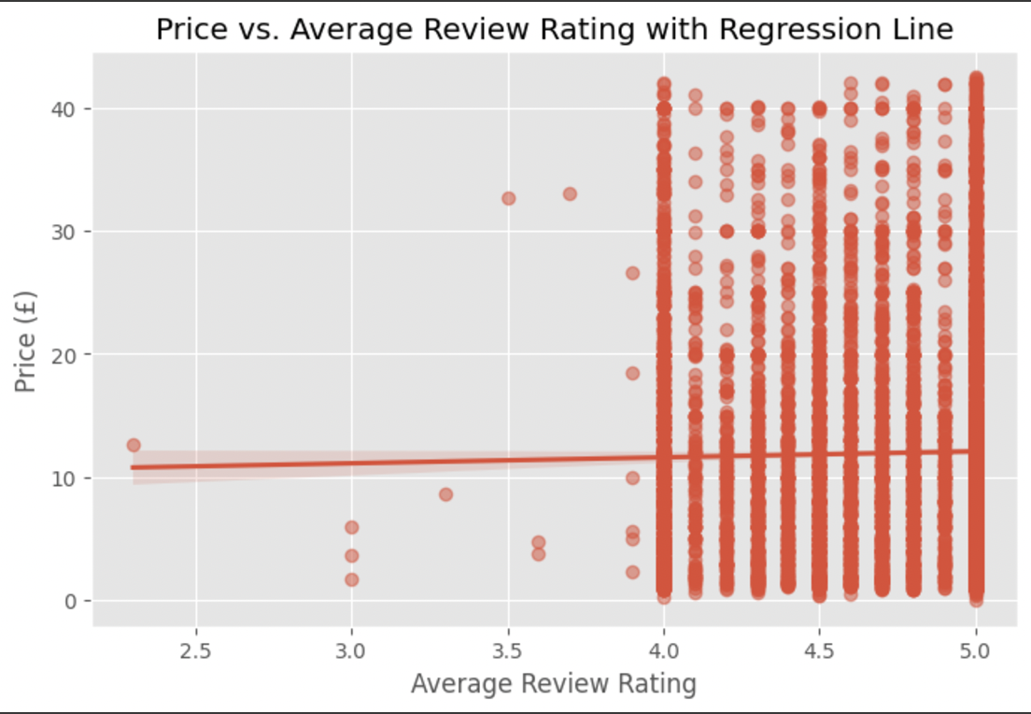
Price vs Average Review Rating
The x-axis represents review ratings, while the y-axis shows the price of products.
The majority of ratings are clustered around 4.0 to 5.0, with very few products rated below 3.5.
The regression line is nearly flat, suggesting a weak or no correlation between price and average review rating.
Products of varying prices, from low-cost to high-cost items, receive similar ratings, indicating that price does not heavily influence customer satisfaction.
A notable pattern is the vertical stacking of data points at discrete rating values (e.g., 4.0, 4.5, 5.0), which suggests a possible rounding effect in how ratings are given.
Notes:
Price vs. Average Review Rating with Regression Line: The regression line is nearly horizontal, indicating that there is almost no clear linear correlation between Price and Average Review Rating. This suggests that ratings have little influence on price, possibly because highly-rated products are not necessarily more expensive, and low-rated products are not necessarily cheaper.

Slide 10
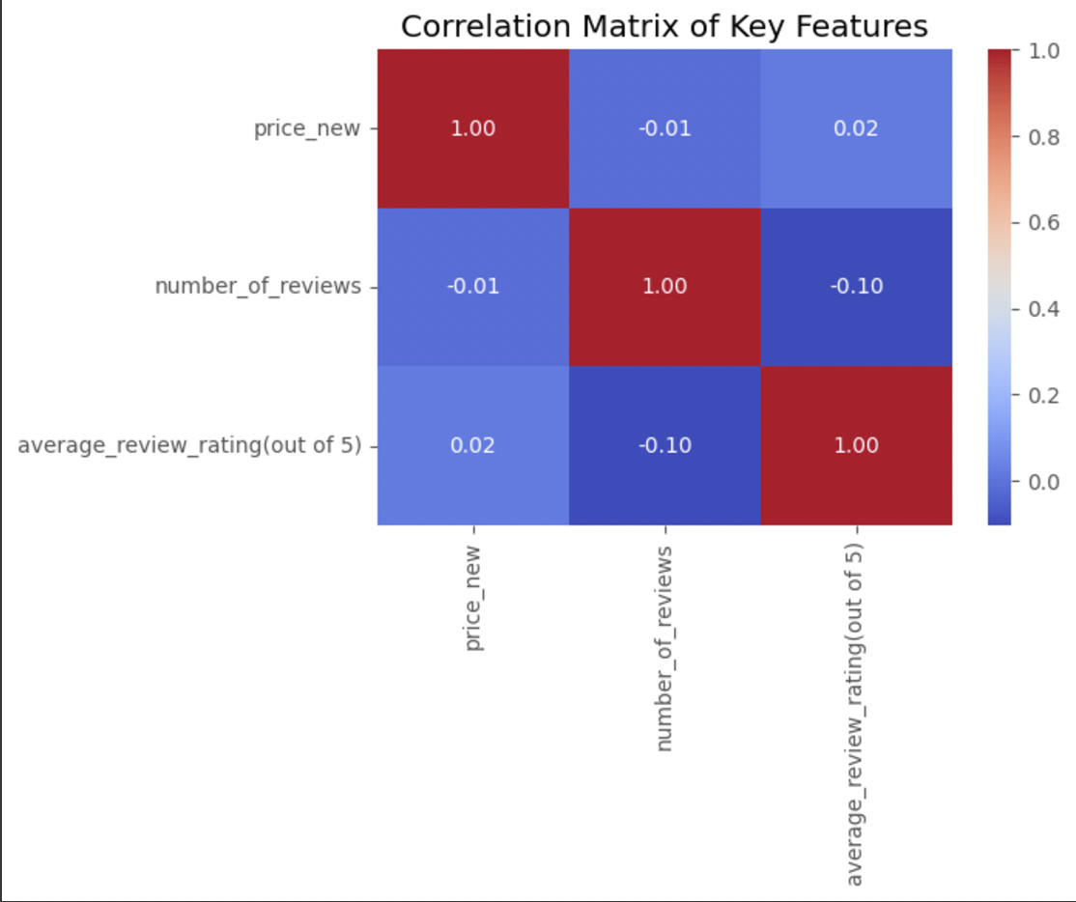
Correlation Matrix of Key Features
Price and Average Review Rating (0.02):
A near-zero correlation, confirming that higher prices do not lead to better ratings.
Number of Reviews and Average Review Rating (-0.10):
A slight negative correlation, meaning products with more reviews tend to have slightly lower ratings.
This could be due to higher exposure, attracting both positive and negative feedback.
Price and Number of Reviews (-0.01):
Almost no correlation, suggesting price does not impact the number of reviews a product receives.
Highly reviewed products may receive more criticism, leading to slightly lower ratings.
Product quality and customer experience matter more for ratings than pricing.
Notes:
Because we couldn't identify a relationship from price and rating alone, we constructed this Correlation Matrix of Key Features. From this chart, we found that there is a slight negative correlation (-0.1) between average_review_rating and number_of_reviews, suggesting that as the number of reviews increases, the average rating may decrease slightly.

Slide 11

Logistic and Linear Regression Models
Logistic Regression
High vs low review impact on price
Correlation Analysis
Price impact on reviews and ratings
Linear Regression
Price impact on reviews and ratings

Slide 12
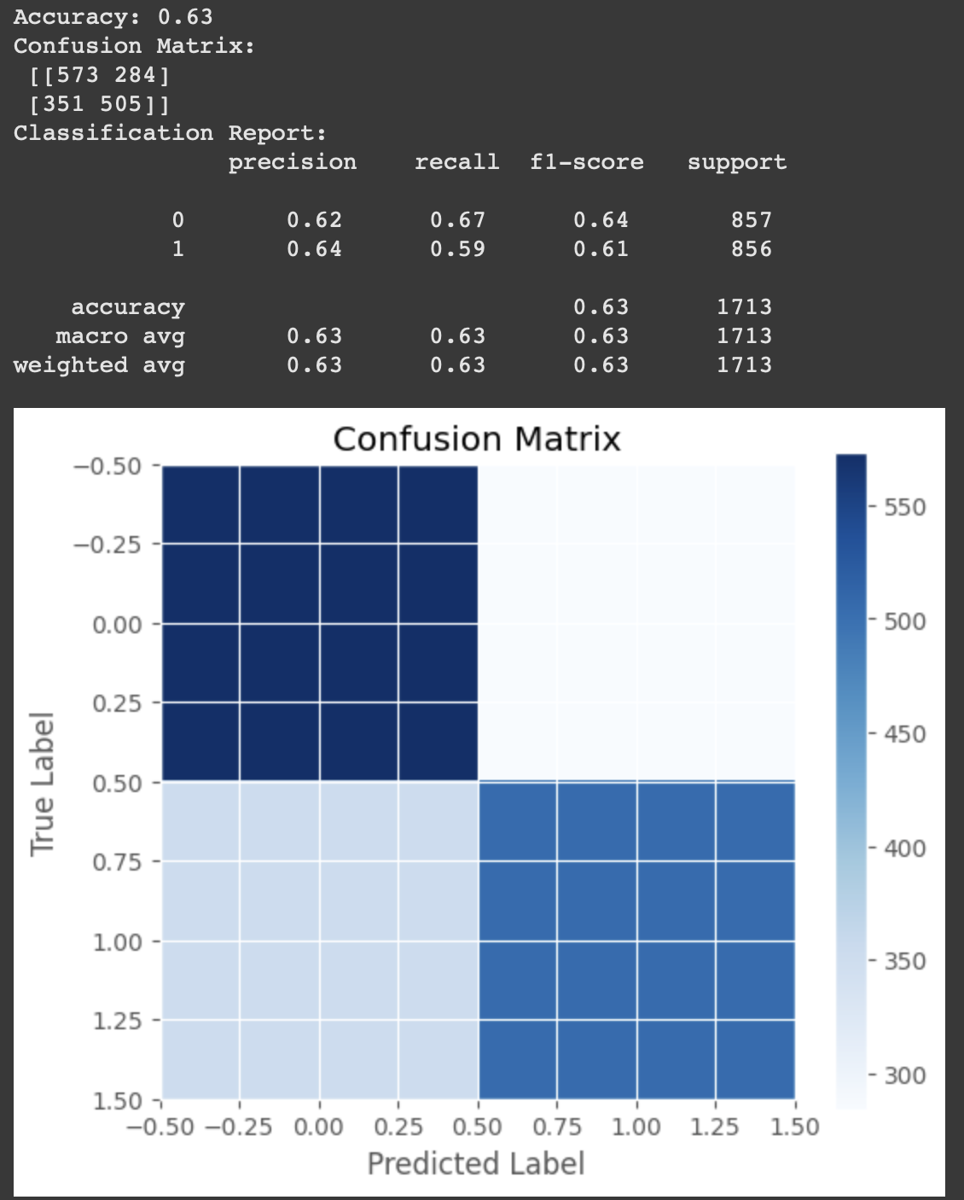
Logistic Regression
Logistic Regression Model (for Review Volume Classification)
We trained a Logistic Regression model to classify high vs. low review volume based on price and product attributes.
The model achieved 63% accuracy.
The confusion matrix revealed misclassifications, especially for mid-tier review counts.
Notes:
we have conducted a thorough analysis to understand the factors influencing product review ratings. We began by cleaning and preprocessing the dataset, removing unnecessary columns, converting price and review-related fields into numerical values, and handling missing data. A correlation analysis revealed that price has almost no relationship with average review ratings, while the number of reviews showed a weak negative correlation, suggesting that more popular products tend to receive slightly lower ratings. The number of answered questions also had minimal impact. Next, we applied a logistic regression model to classify products as having high or low review volumes, achieving 63% accuracy. However, the model struggled to differentiate mid-range review counts, highlighting overlapping characteristics between categories. Finally, we built a linear regression model to predict review ratings using price, number of reviews, and number of answered questions. The model performed poorly, with an R² score of just 2.27%, indicating that these features do not strongly determine review ratings. The regression coefficients showed that price and customer engagement metrics had little to no impact, reinforcing the idea that other factors, such as product quality, brand reputation, or review sentiment, likely play a larger role in determining ratings.

Slide 13
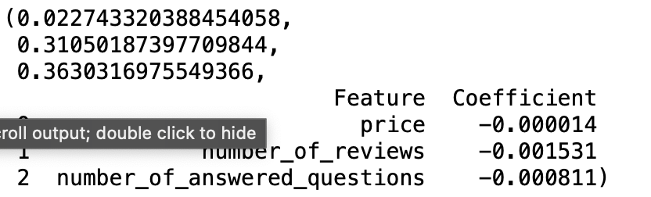
Linear Regression
Price, review volume, and answered questions do not strongly predict review ratings.
The model performs poorly (R² = 0.0227), meaning other factors (e.g., product category, review text sentiment, brand reputation) likely have a stronger influence.

Slide 14
Regression Model Results
Price alone does not drive review scores. Other aspects like brand reputation, product quality, and customer sentiment may be more important.
More reviews tend to slightly lower ratings, likely because popular products receive more diverse opinions.
The model struggles to predict ratings accurately, suggesting that text-based sentiment analysis or category-based comparisons may be better approaches.
Price is not a strong predictor of review ratings
Popular products tend to receive slightly lower ratings
Customer engagement (answered questions) does not significantly influence ratings
A simple linear model is insufficient to predict review ratings
Mid-range review volumes are harder to classify
Overall, these findings indicate that while price, review volume, and customer engagement play some role in product perception, but they are not the main drivers of review ratings.
Notes:
Price is not a strong predictor of review ratings – Since the correlation between price and average review ratings is nearly zero, we can predict that raising or
lowering a product’s price alone will not significantly affect its rating. Instead, factors such as product quality, brand reputation, or customer experience likely
have a greater influence.
Popular products tend to receive slightly lower ratings – The weak negative correlation between the number of reviews and average ratings suggests that as more people review a product, the likelihood of mixed or negative opinions increases. We can predict that widely purchased products may accumulate lower average ratings over time due to increased scrutiny.
Customer engagement (answered questions) does not significantly influence ratings – Since the number of answered questions showed no strong correlation with review ratings, we can predict that increasing customer interactions (through FAQs or Q&A sections) will not necessarily lead to higher or lower ratings.
A simple linear model is insufficient to predict review ratings – The linear regression model’s low R² score (2.27%) indicates that price, review volume, and answered questions alone do not explain rating variations. This suggests that other hidden factors—such as brand perception, customer sentiment, or product-specific features—are more relevant.
Mid-range review volumes are harder to classify – The logistic regression model showed that distinguishing between high- and low-review products was relatively effective, but mid-range products had overlapping characteristics. This suggests that products with moderate popularity are more unpredictable in terms of review volume trends.

Slide 15
Random Forest Model
Data Process
Loading the data and handling missing values
Process Imbalance Data
Use SMOTE to balance the dataset
Model training &Cross Validation
Split the dataset and use 5-folds
Notes:
For this question I used Random forest. The goal of this question is to classify products into three price categories: Low, Medium, and High, based on their features like manufacturer, reviews, and text descriptions.
By the way, low price represent price less than 10, medium greater than10 and less than 30, otherwise are count as high price

Slide 16
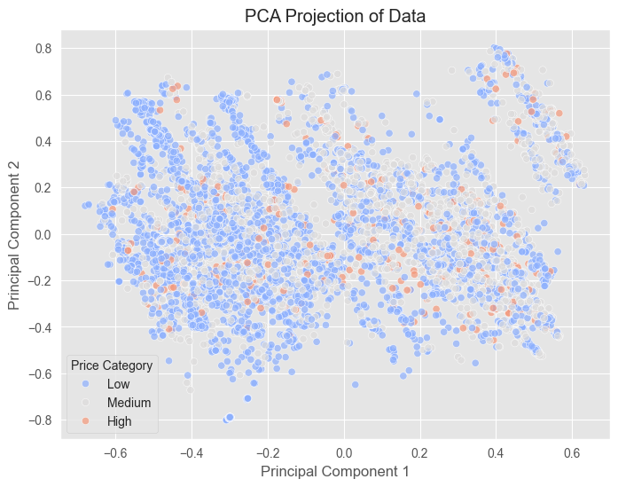
Notes:
At very beginning of this project, I used a Bayesian model on this question, but after two rounds of upgrades, the final accuracy only reached 62%. This is because Bayesian methods are probability-based linear models that assume the features are independent. In fact, this is evident from the PCA plot I generated at the end of the model, which clearly shows that, unlike the examples we saw in last class, our data does not have a distinct linear boundary. Therefore, I decided to change the model, and after some research, I learned that random forests can capture complex non-linear relationships because each decision tree can learn different patterns in the data.

Slide 17
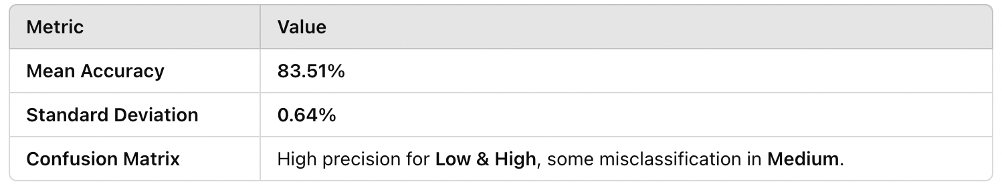
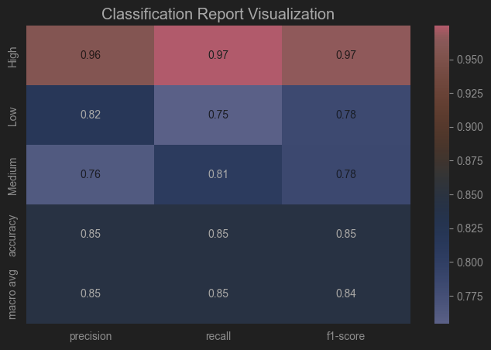
Random Forest Model
Objective: Improve price category (Low, Medium, High) classification using Random Forest with advanced feature engineering.
Methodology:
Feature Engineering: ✔ Encoded categorical features (manufacturer, category). ✔ Extracted text-based features from customer Q&A. ✔ Applied TF-IDF vectorization on combined text data. ✔ SMOTE for class balance in training.
Model: Random Forest Classifier (100 estimators).
Evaluation: Stratified K-Fold (5 splits) for stable performance assessment.
Notes:
I start by loading the data and handling missing values. Any missing values in numerical columns are filled with their median values, while categorical values are encoded using Label Encoding.
These are the features I implied
Beyond that we extract features from the text, like the number of questions, text length, and unique word ratio which are also numerical features
We apply TF-IDF Vectorization to convert textual data into numerical, selecting 2000 key features from product descriptions.
Why 2000? Because base on the research, max_features is best between 1k-5k.
And because we used SMOTE, to avoid massive calculation we decided use 2000 features
SMOTE:
Our dataset is imbalanced, that some price categories appear more than others.
To solve this we use Synthetic Minority Over-sampling Technique to balance the dataset by generate new samples
After all of these we can start model training. To ensure robust evaluation稳定的评估, we implement Cross-Validation (5-folds) that we learned from last lecture, by using function stratifiedkfold() and set n_splite to 5
Then we split the dataset into training and testing and train a Random Forest model with 100 decision trees
Finally, our Random Forest model achieved an average accuracy of 83%
Std=0.0064. means the model is very stable across different data splits and doesn’t vary much with changes in the training data
Precision = 0.96: Among the products predicted as "High," 96% are actually high-priced. Recall = 0.97: Among all truly high-priced products, 97% were correctly classified. F1-score = 0.97: The classification performance for high-priced products is excellent.

Slide 18
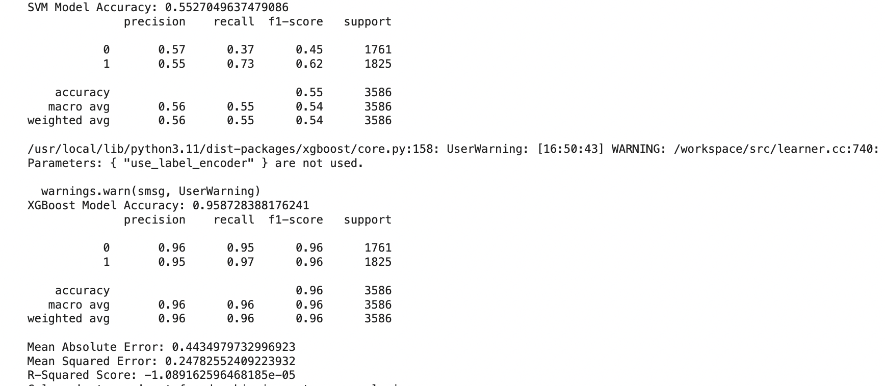
SVM and XGBoost Model
Objective: Analyze product descriptions and predict sentiment using machine learning.
Methodology:
Sentiment Analysis: Used VADER to classify reviews as positive (1) or negative (0).
Text Preprocessing: Stopword removal, lemmatization, and TF-IDF vectorization.
Feature Engineering: Combined text features (TF-IDF) with numerical features (price, rating, review length).
Class Imbalance Handling: Applied SMOTE for balanced training data.

Slide 19
Summary
Price does not impact ratings – Raising or lowering a product’s price alone will not significantly affect its rating. Other factors like quality, brand reputation, and customer experience matter more.
Popular products get slightly lower ratings – More reviews lead to greater scrutiny, increasing the likelihood of mixed or negative feedback.
Customer engagement does not affect ratings – Answered questions and FAQs do not strongly influence product ratings.
Linear regression is ineffective for predicting ratings – Price, review volume, and answered questions explain only 2.27% of rating variations, suggesting other factors like brand perception and sentiment play a bigger role.
Mid-range review volumes are unpredictable – It’s easier to classify products with high or low review counts, while mid-range products show overlapping characteristics.

